Slide 1
People CMT
Corona Virus CoVID-19
November 3 2020

Slide 2

People CMT Agenda
General information Michael
Belgium / Gent - Update Walter
Americas Mikael / Terrial / Åke
Global Overview/OTD Danny
Travel update Lisa
Corporate communication plan Stefan/
IA Update Nina/Tommi Rantanen
Workplace Marcus/Lisa
Round the table
Other All
Next meeting 10 November October
2019-12-10 Issuer: Stephanie Viklund, sviklund, Health . Safety & Security, Security Class: Proprietary

Slide 3
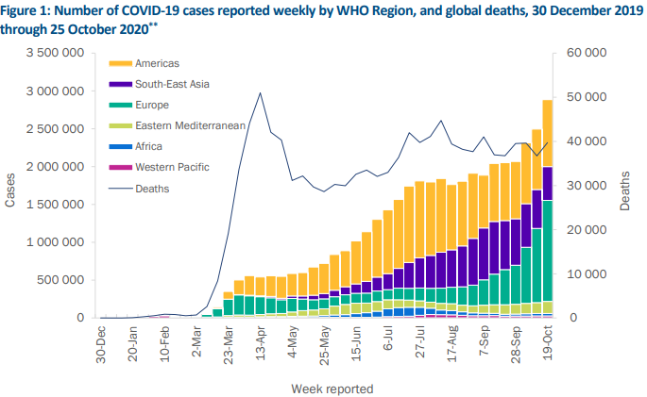
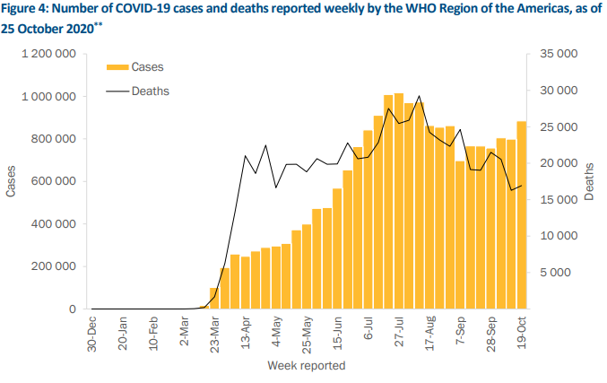
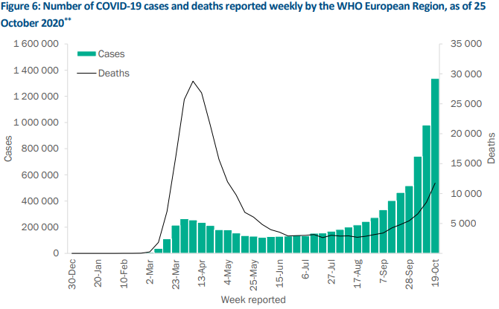
COVID19 Weekly overview November 3
46.6m cases, 1.2m deaths. Week43: 2,9m new cases Europe cases up 36%, fatalities up 37%, ​11% more new cases in Americas.
  Preliminary W44 will be 3.35m with Europe up approx. 25% and Americas 15%.
Europe –ECDC – 14 day new infection rate 360/100k people (+110). Highest in Belgium (1753/100k +18), Czech 1586 100k + 25) and Slovenia (1082/100k +1). Sweden 203/100k. 24 countries experiencing’s high and increasing levels of hospitalisation.
  Fatality rate of 26 (+9) per 1m, high level and sustained increase in fatalities in 22 countries.
  From data available estimate that 18% of reported COVID-19 cases have been hospitalised, 7% of hospitalised patients required ICU and/or respiratory support
  The epidemiological situation in the majority of countries in the region are classified as of serious concern, where there is a high risk to the general population and a very high risk for vulnerable individuals.

Slide 4
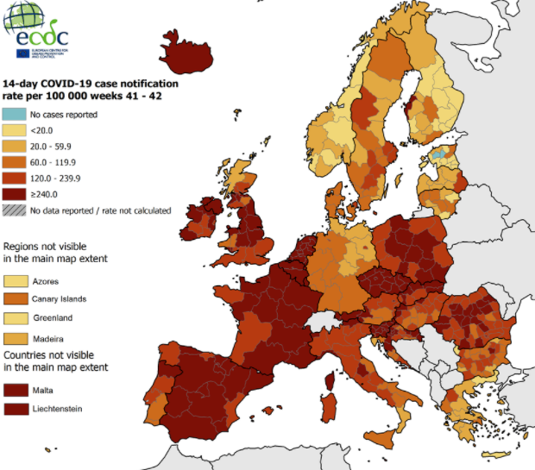
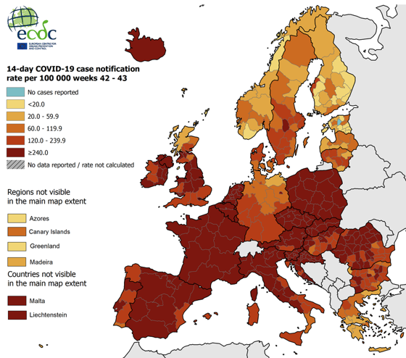
Last week This week

Slide 5
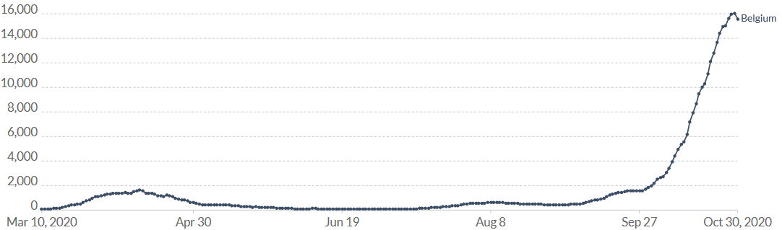
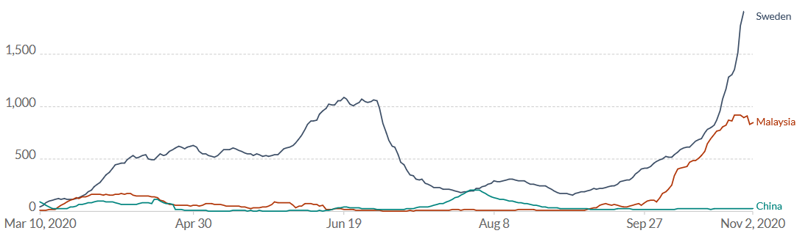
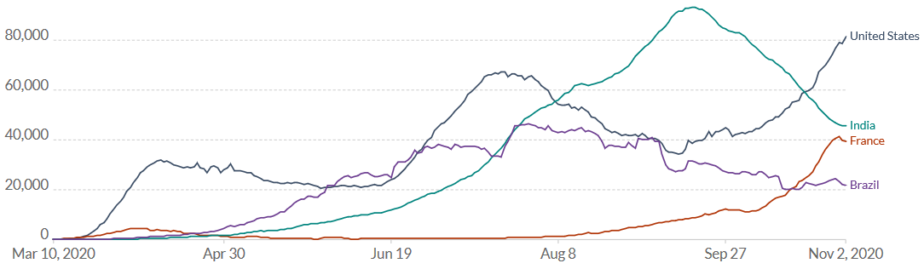
Seven day new case averages
Belgium – curfew and national lockdown for six weeks, provisions for essential business to remain open. Schools extend their mid-term break but re-open 16 November. Mandatory work from home if you can.
Sweden –Increases in cases and hospitilisation. Cases increasing rapidly over the last days. Advice in many areas has been expanded and language has been strengthened.
Increased number of regions coming under enhanced requirements, further limitations on gatherings, flag increased case numbers and hospitalisation rates.
Malaysia – Conditional movement control order included KL and states extended until 9 November. Travel between districts prohibited. Workers must show documentation to move.
  China – 137 cases initially detected in Kashgar, Xinjiang province a further 6 since.
  US – Over 9m cases, high numbers of cases continue to increase in 42 states and territories, and low but increasing numbers are reported from 10 states and territories. Only Hawaii and Louisiana have low stable COVID-19 activity. Hospitalisation on the rise nation wide and fatalities increasing. Some hospitals are reported as becoming overwhelmed (Utah, Tennessee, Idaho).
The Midwest and West remain hotspots for activity in late October. Texas, Illinois, Wisconsin, California, Florida and Michigan have reported the highest numbers of cases in the last week. Per population, North Dakota and South Dakota are currently the worst affected states.
From 6 November Connecticut will tighten restrictions back to Phase 2.1 rules, including limits on restaurants and gatherings. New restrictions in Massachusetts will include a stay-at-home advisory in place from 6 November.
  India – upcoming festival season has potential to reverse downward trend. This has potential flow on impact for workforces. Decline continues with less than 50,000 cases reported daily. Testing capacities have improved and at least 1,500,000 can be done in a day.
  France – A nationwide lockdown is now in effect until at least 1 December, schools and factories will remain open. Non-essential businesses will be closed or moved to telework if possible. People will be allowed to leave their homes to buy essential items, get medical care or exercise for a maximum of one hour. Daily COVID fatalities are the highest they have been since April.Looking for infections to stabilise between 3-5000cases per day.

Slide 6
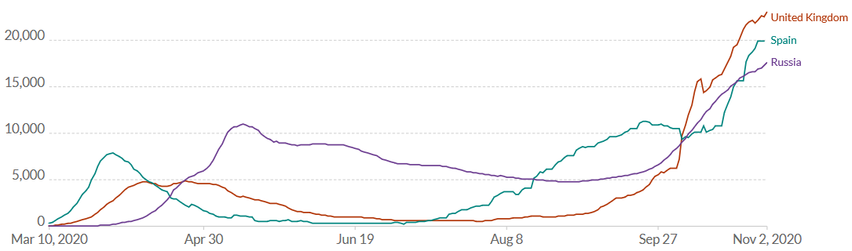
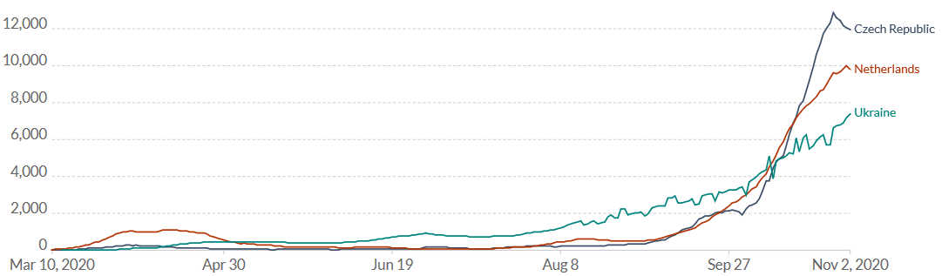
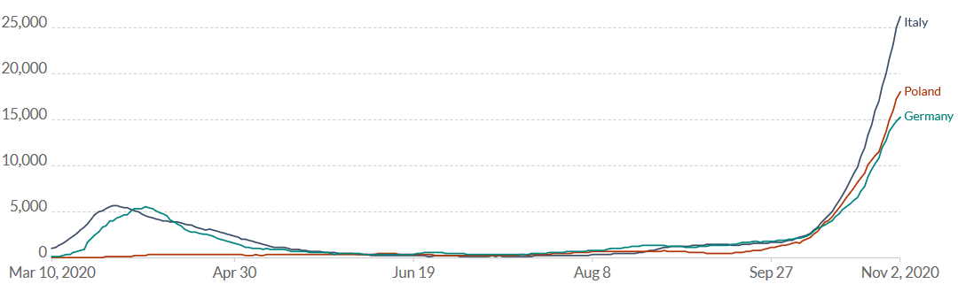
  Spain – Second nationwide state of emergency. Overnight curfews have been ordered across the country. Madrid entry and exit restrictions extended until 4 November. Further regional actions being taken (Murcia closed regional border to all travelers)
  Czech – Extended until 3 December. Curfews from 9pm to 5am, movement restrictions during daytime and reduced business hours. Growing number of infected healthcare workers is impacting ability to respond. Press conference – seeing the R number go down, increases are declining, encouraging but too soon to be sure.
  UK – New restrictions in England from 5 November until 2 December. Say at home and non essential business will close. Everyone who can must work from home. Schools remain open. Ireland and Wales under lockdown.
  Russia – daily high case numbers continuing, nationwide masks and curfew, a fifth COVID hospital has opened in Moscow.
  Netherlands - Partial lockdown. Some hospitals across the country have stopped admitting COVID-19 patients as ICU's and special corona wards are full.
  Germany – Accelerating transmission. increased to 115 per 100k (+16) with 197 (+58) districts exceeding 100 cases per 100k, 23 exceed 200 per 100k (+8). Incidence in Bavaria, Berlin, Bremen, Hesse, North Rhine-Westphalia and Saarland higher than the national average. Proportion of cases in older age groups has been increasing. COVID-19 patients requiring intensive care has almost tripled in the past 2 weeks. Lockdown light.
  Italy – Curfew now in place nationwide. Cases are surging particularly in northern Lombardy and Piedmont regions. Flagged upcoming advice citizens to not travel out of Italy. Gov’t flag lockdown overcoming days. Not expected to be as harsh as first.
  Poland – Whole country considered red zone. Restrictions on the movement of under 15s and seniors. Distance learning for most school groups. Field hospitals being opened.

Slide 7
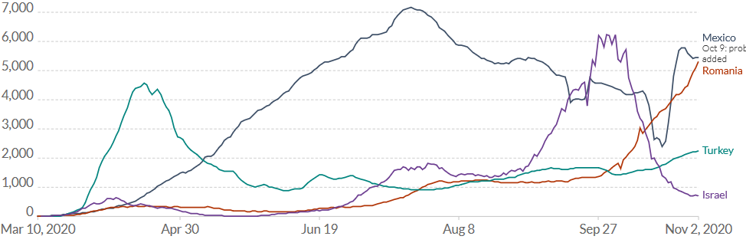
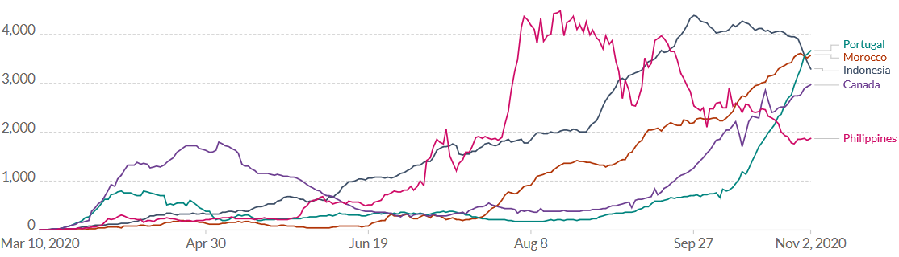
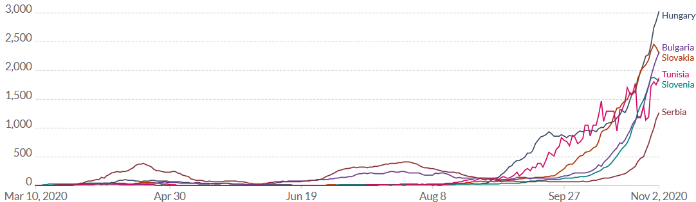
  Mexico – gov’t acknowledge that death toll is much higher than reported.
  Austria – Curfew in place until end November. Closure of pleasure activities.
  Turkey – Health minister not looking at measures.
  Philippines - general quarantine extended until 30 November. Modified levels exist in some provinces.
  Indonesia – holiday long weekend expected to cause a spike in cases but unlikely to lead to reimposition of restrictions.
  Tunisia – National Curfew - Non-essential movement between provinces will be prohibited. Primary and middle schools will be suspended until 8 November.
  Romania – now at highest case levels per day.
  Bulgaria – cases still rising sharply, Sofia considered a hotspot. Mandatory mask usage.
  Slovenia – 7 of 12 regions high risk, movement restriction between regions. Nation wide curfew from 2100-0600.
  Slovakia -aim to test everyone by mid November. Partial lockdown and nationwide curfew in place.
  Hungary – managing 25,000 active infections.
  Portugal - partial lockdown in most of the country, restrictions on non-essential movement, from 4 November until further notice.

Slide 8
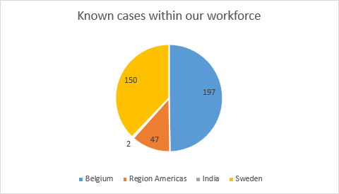
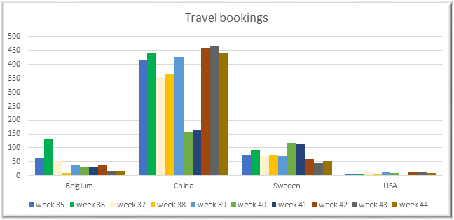
Internal update
405 known cases; 159 Sweden (31 last week. 7 so far this week), 47 Americas Region, Belgium 197 (55 last week), and 2 India.
Business critical travel only – SharePoint updated, all bookings in the next month were contacted. Future bookings will be emailed.
  EU destinations are harder oncemore – some have mandatory quarantine periods on entry and/or reimposing testing. Expect Belgium to list VG Region as red in coming days.
We are tracking developments for testing and exploring how these could complement our approach.
Corporate Comms are re-looking at all of our visual communications. They will present options which can be used across our workspaces
  The hub has been updated.
Managers flow chart is being updated with the key change being that we look back 24hrs from symptoms.
Decisions (made)
Travel Business critical only.
Limit non necessary face to face interactions as much as possible.
Decrease congestion within our facilities and re-look at areas which may still be a cause of congestion.
Updated messaging and communication to employees who can work from home, and managers.
Challenges
Maintaining a fact based approach and ensuring calm.
‘COVID fatigue’– people become blind to the same messaging - social distance, maintain hand hygiene, and stay home if sick. Our first actions are still the right ones.
  Compliance with our mitigation measures.
External factors; schools and changing government policy; cluster or outbreak in a critical team/supplier.

Slide 9
Last week This week
44.4m cases, 1.17m deaths. Last week, 2,9m new cases Europe cases up 36%, fatalities up 37%, ​11% more new cases in Americas.
  On the steepest rises since the start of the pandemic. Exponential increase in Europe.
Europe –ECDC – 14 day new infection rate 360/100k people (+110). Highest in Czech 1481/100k), Belgium (1498/100k) and Slovenia (878/100k). Sweden 159/100k. 24 countries experiencing’s high and increasing levels of hospitalisation.

Slide 10
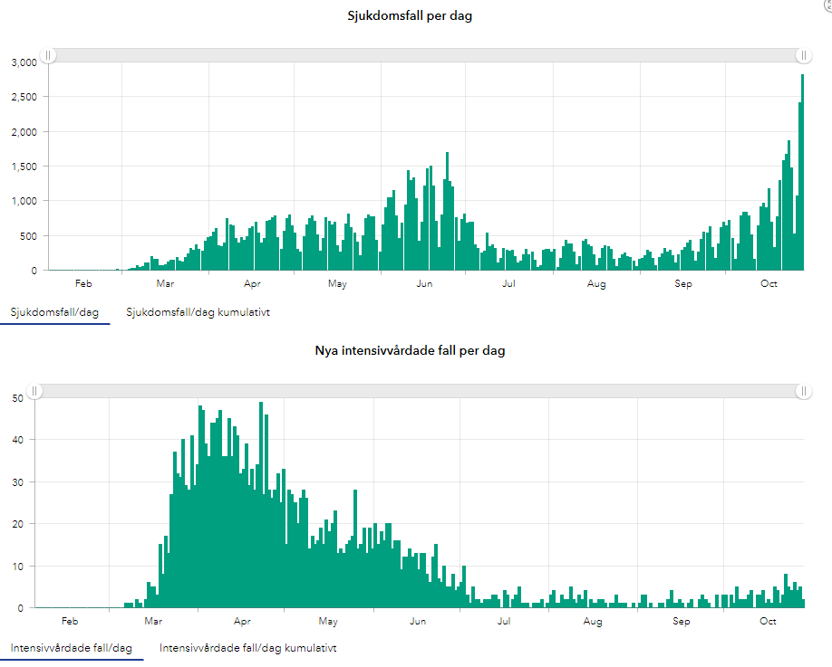
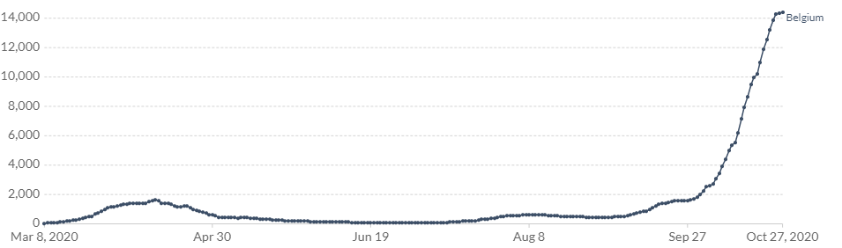
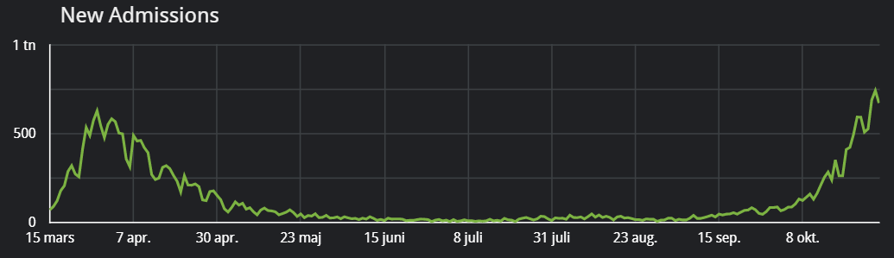
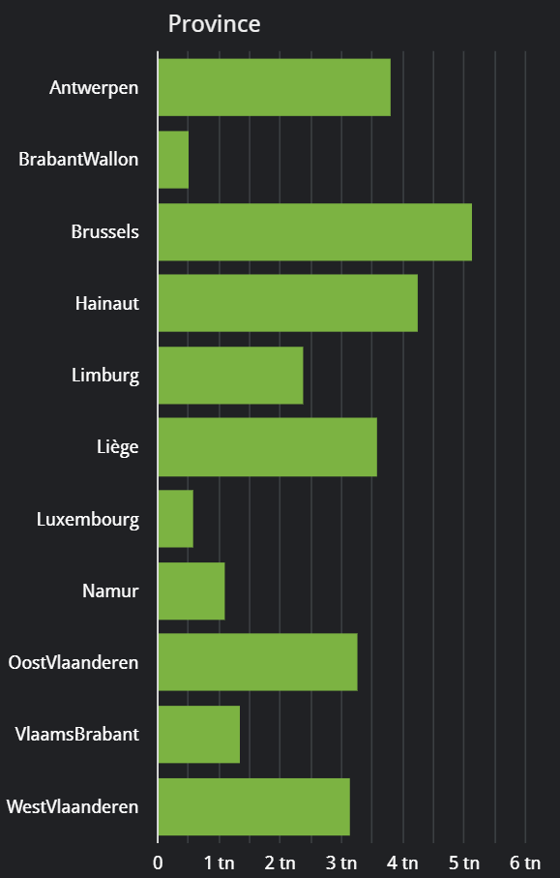
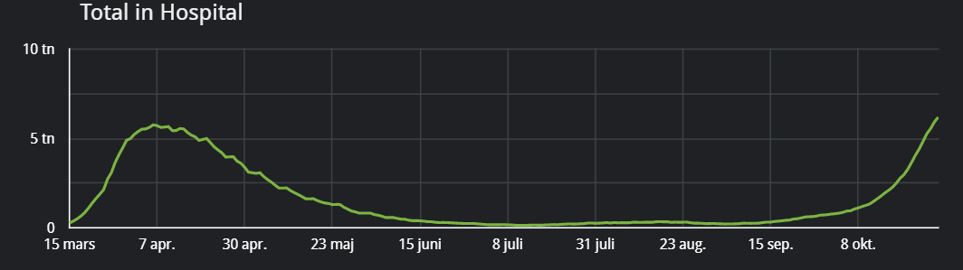
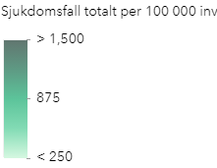
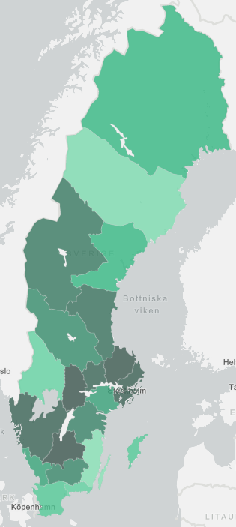
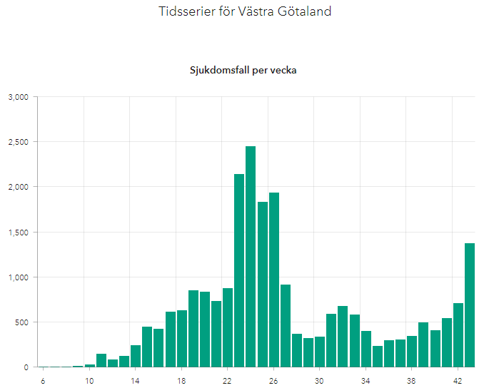
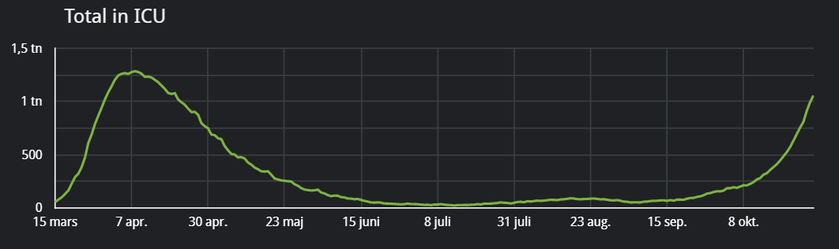
Belgium Sweden
Notes:
VG Region 566 cases Tuesday to Thursday.
Belgium to meet today.

Slide 11
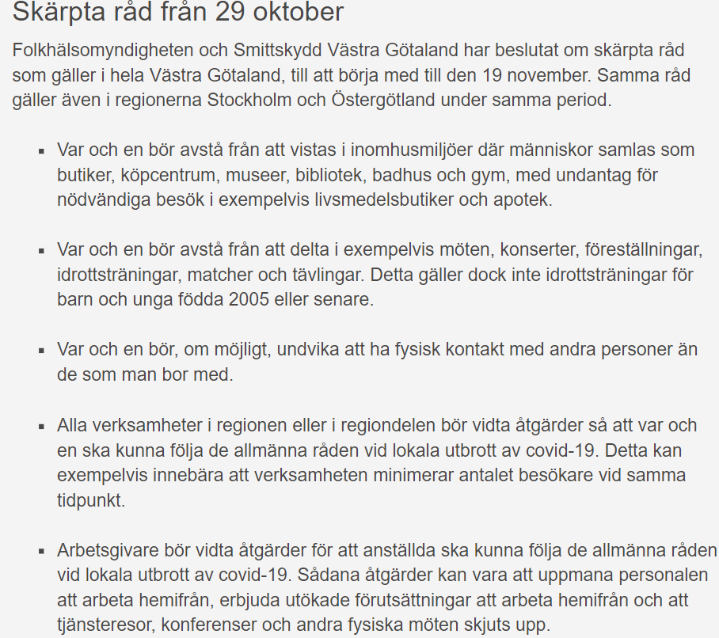
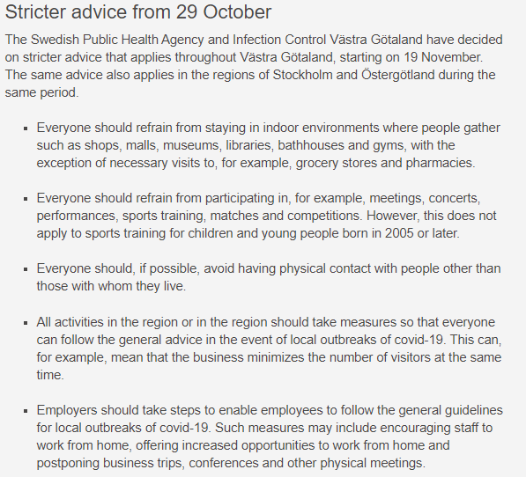

Slide 12


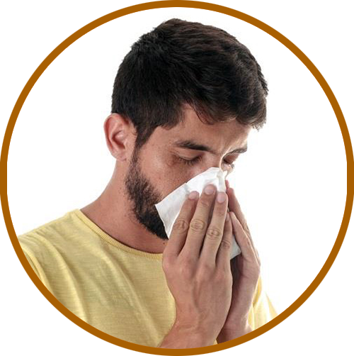

Stay Well
Wash your hands
Wash your hands often with soap and warm water.
Alcohol-based hand rub can be an alternative when
you are unable to wash hands.
Stay at home if you have any symptoms
Stay at home when you’re sick – even if your symptoms are mild – to avoid infecting people on the bus, at work or in areas where you are close to others.
Sneeze into the bend of your elbow
or into a tissue
Cough and sneeze into the bend of your elbow or into
a tissue to prevent infection from spreading around you, or from contaminating your hands.
Avoid touching your face
A general preventive measure against respiratory infection is to avoid touching your face and eyes
and to avoid close contact with sick people.
Source: Folkhälsomyndigheten, Public health agency of Sweden

Slide 13
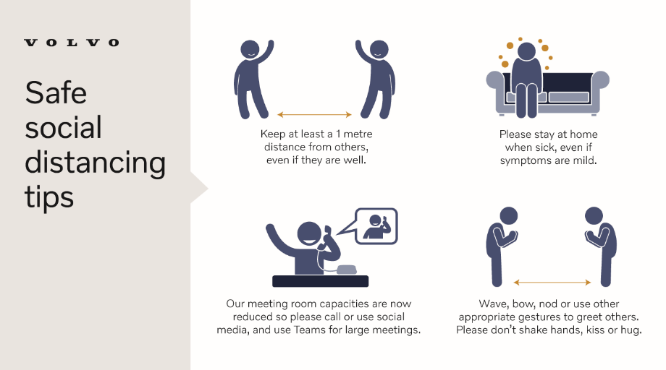

Slide 14
Preventive actions to keep you safe at work
Our expert teams have been working tirelessly to prepare our work spaces for your return.
Here’s the latest on what’s been done to improve your health and safety at work.
General
You’ll notice a lot more visible advice around our premises.
The Intranet is a great place to find the latest information.
Your line manager is also available to answer questions.
Cleaning
While you were away, we’ve thoroughly cleaned and sanitised our work areas.
We have new strengthened cleaning routines – especially more regular cleaning of frequently used surfaces.
More sanitising products are available throughout our work spaces.
Entrance points
At the main entrances,
you’ll have the voluntary opportunity to check your temperature.
Feelgood staff are available to answer general health questions – drop in times
are available.
We’ve placed visible information throughout
our work spaces.
Work area
Localised plans depending on site needs.
Social distancing – our baseline is
1m minimum.
Your work areas have been checked
to ensure there is more than 1m from others, or where not possible, other protective measures are in place.
Meeting room capacities have been halved; online meetings still recommended.
Restaurants
Social distancing increased.
Now with more takeaway options.
As mentioned above, your manager and the Intranet are your best starting points for your questions.
And don’t be shy – contact our fantastic staff at Feelgood if you have any general health questions.

Slide 15
